Slide 1
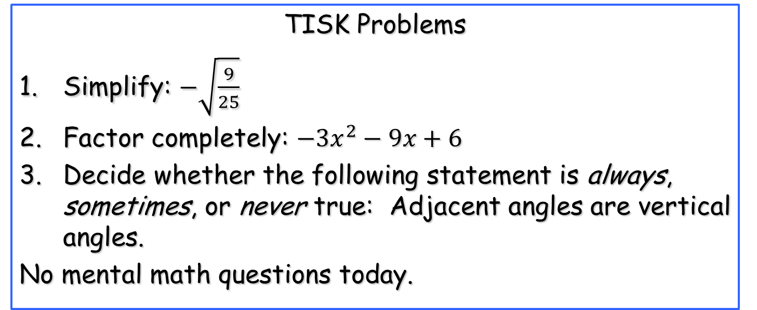
Wednesday, September 26, 2012
Homework: p. 185 #31, 34, 43 & 44 (36-42 mentally)
TISK Problems
Simplify: $−\sqrt{\frac{9}{25}}$
Factor completely: $−3x^{2}−9x+6$
Decide whether the following statement is always, sometimes, or never true: Adjacent angles are vertical angles.
No mental math questions today.

Slide 2
§4.1 Triangles & Angles
Definitions
Equilateral Triangle
All 3 sides are congruent.
Isosceles Triangle
At least 2 sides are congruent
Scalene Triangle
No sides are congruent.
These are classifications by SIDES.

Slide 3
Definitions, continued.
Acute Triangle
All 3 angles are acute.
Equiangular Triangle
All 3 angles are congruent (is also acute).
Right Triangle
One right angle.
Obtuse Triangle
One obtuse angle.
55º
70º
55º
These are classifications by ANGLES.

Slide 4
More Definitions
vertex
vertex
A vertex is the point that connects the sides of the triangle.
vertex

Slide 5
More Definitions
vertex
adjacent
sides
Two sides with a common vertex are adjacent.

Slide 6
More Definitions
Hypotenuse: the side of a right triangle that is opposite the right angle.
hypotenuse
leg
Legs: adjacent sides that form the right angle in a right triangle.
leg

Slide 7
More Definitions
Base: the side of an isosceles triangle that is not (necessarily) congruent to the other two sides.
leg
leg
Legs: the congruent sides of an isosceles triangle.
base

Slide 8
Classify the triangle by its angles and its sides.
45º
60º
75º

Slide 9
Classify the triangle by its angles and its sides.
45º
90º
45º

Slide 10
How many degrees does a triangle have? How do you know?

